Slide 1
Simulation of Quantum Dots
Group Project by Matthias Dittberner and Christian Funck

Slide 2
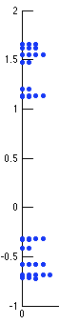
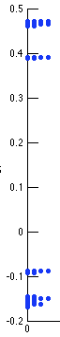
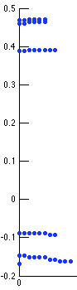
Energy levels for PbS QDs
Band edges: 8 quasi degenerate energy levels.
2nm QD
10nm QD
10nm QD, better visibility for (quasi) degenerate states.

Slide 3
Wave functions for band edge states, big QDs
Spherical shape: „1S orbitals“
Probability density for a CB state near bandedge, of a 8nm QD.

Slide 4
Wave functions for higher modes
Non spherical shapes: Probability density for CB modes 10, 14, 20.

Slide 5
Wave functions for small QDs
Near Band edge states: spherical symmetry of wave fn is lost for some states.
Close to reality?
Probability density for CB mode 3 of a 2nm QD.

Slide 6
Energy levels and electric field
Energy levels for a 5nm QD plotted against applied electric field.
Band gap gets smaller for higher fields.
8-fold degeneracy of band edge states is lost (twofold degenerate states remain).

Slide 7
Wave functions and electric field
Shift of wavefunction, depending on hole-like resp. electron-like character, to the left or right.

